Slide 1
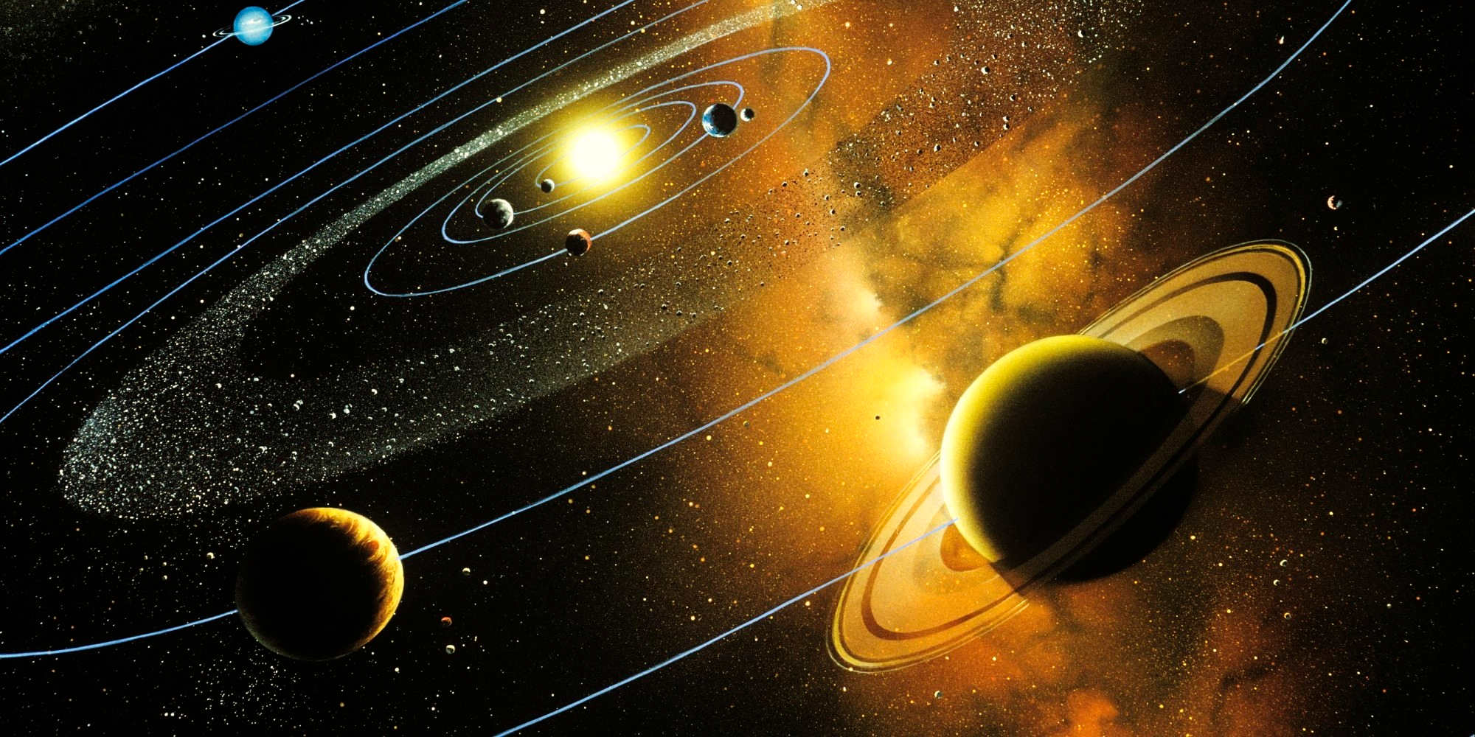
Simulation of The Solar System
Seth Kaminski - 300788677
Selina Daley - 30792374
Khandker Hussain - 300773610
Slade Sieger - 300814981

Slide 2
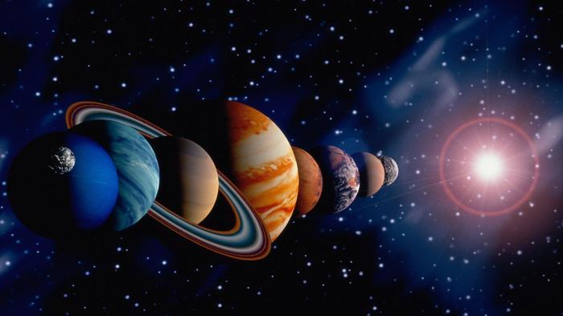
Original System The Solar System
Consisting of the following planets:
Inner Planets:
Mercury
Venus
Earth
Mars
Outer Planets
Jupiter
Saturn
Uranus
Neptune
Dwarf Planet
Pluto

Slide 3
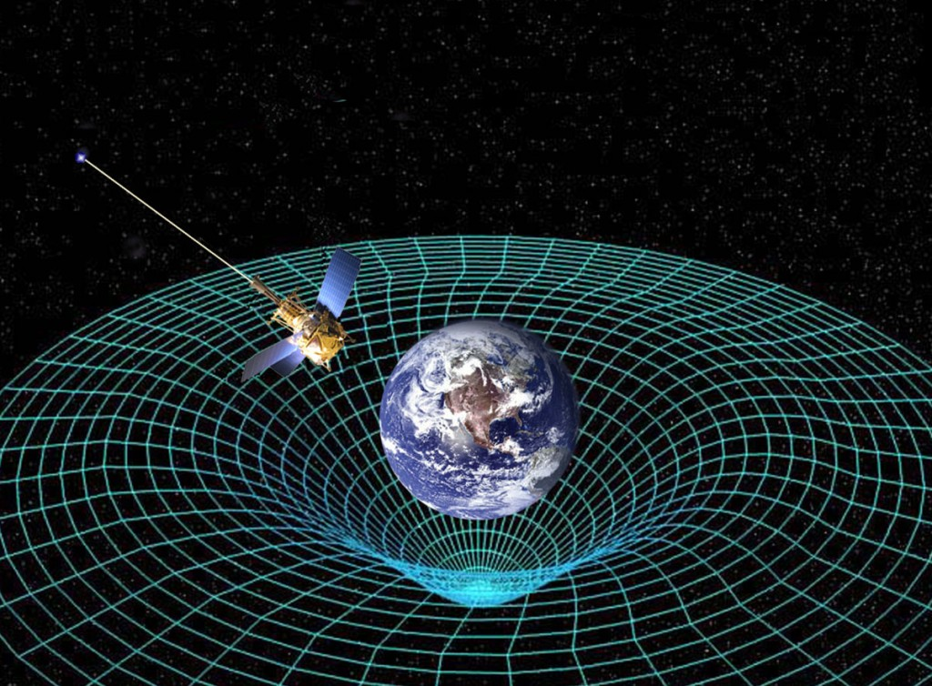
Observable Elements The Planets’ Gravitational Pull
Mercury - 3.7 m/s2
Venus - 8.87 m/s2
Earth - 9.81 m/s2
Mars - 3.71 m/s2
Jupiter - 24.79 m/s2
Saturn - 10.44 m/s2
Uranus - 8.69 m/s2
Neptune - 11.15 m/s2
Pluto - 0.62 m/s²
Notes:
Sources:
http://planetfacts.org/gravitational-pull-of-the-planets/
http://www.universetoday.com/35565/gravity-on-other-planets/

Slide 4
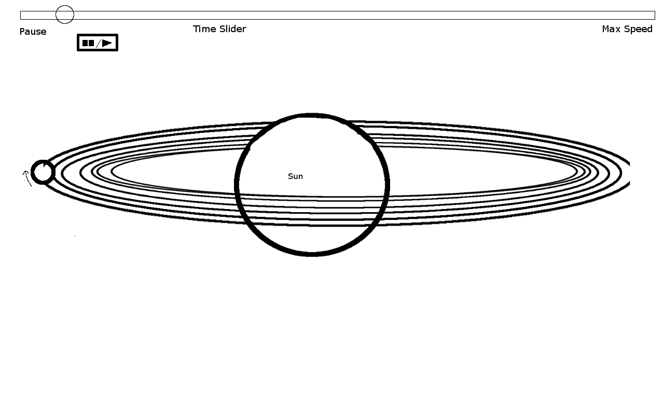
Conceptual Model
The HUD and a sample
of the simulation

Slide 5
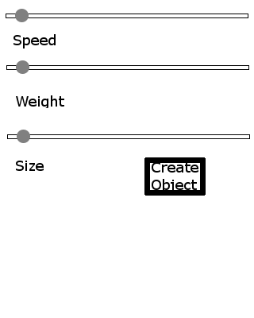
Conceptual Model Foreign Object Creation Menu

Slide 6
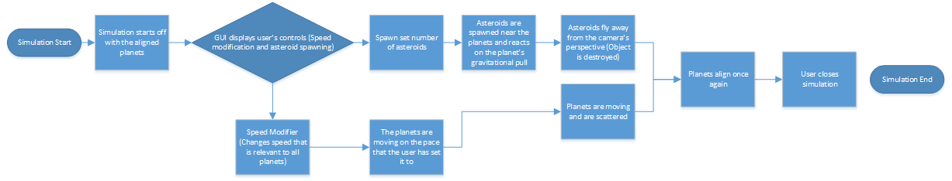
Conceptual Model Simulation Flowchart
Notes:
Does this make sense to you guys? If not, I shared all of my files on slack and google drive and I can change it if you want.

Slide 7
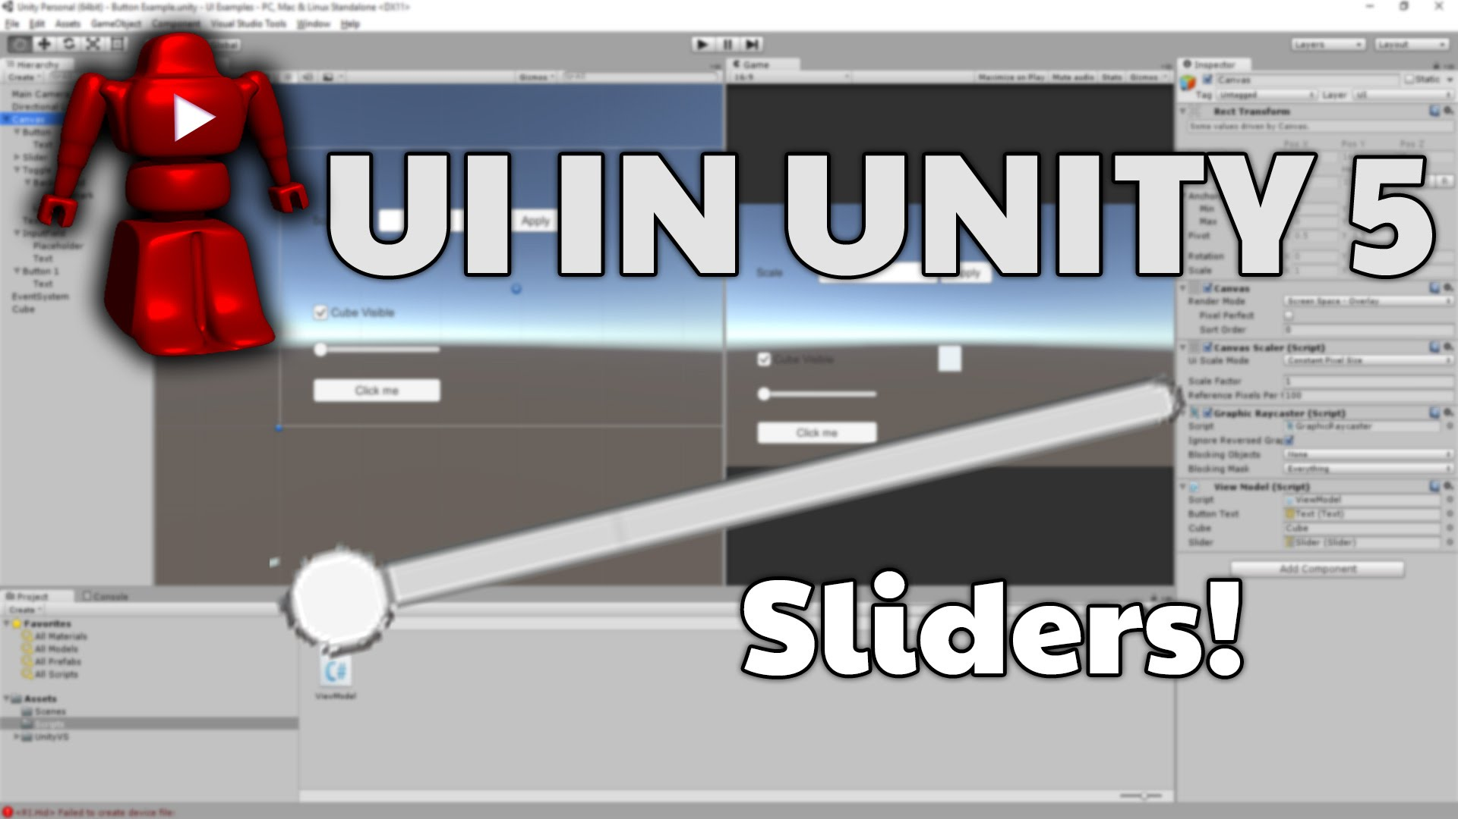
Conceptual Model Time scale
A slider could be created that speeds up/ slows down the scale of time for the simulation.

Slide 8
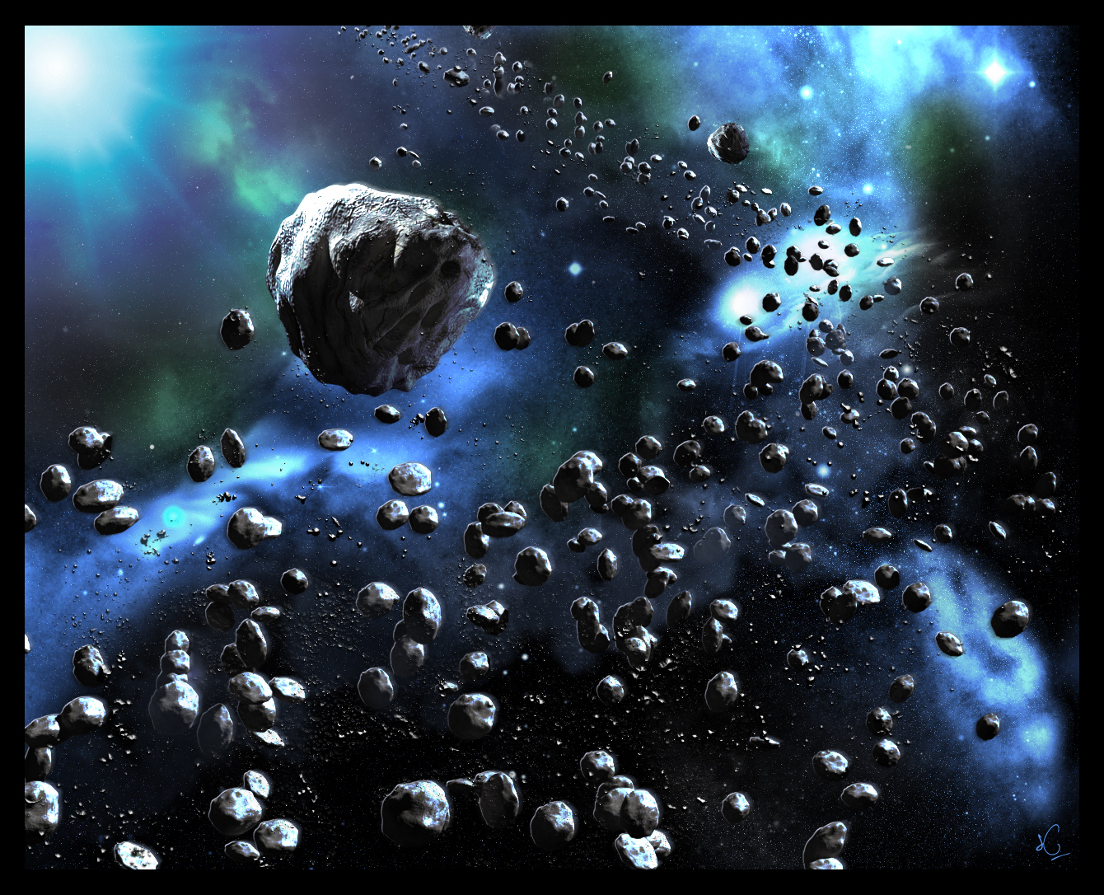
Conceptual Model Simulating outside factors on planets
Asteroids get created and given stats (speed, weight, size) with a set of menus. The asteroids then affect the planets based on these stats.

Slide 9
Conceptual Model Simulating the effects of the sun on the planets
On a planet being affected by the user (the user moves a planet outside of its normal orbit.) it determines how this would affect the planet with a text box.
For example, the earth being moved to close to the sun would cause water to evaporate.

Slide 10
Conceptual Model Show user's effects on the planets
On a planet being affected by the user, a text box appears and tells the user what that action had on the planet
For example, if the earth has its rotation stopped, it would cause problems with the planets’ plates.

Slide 11
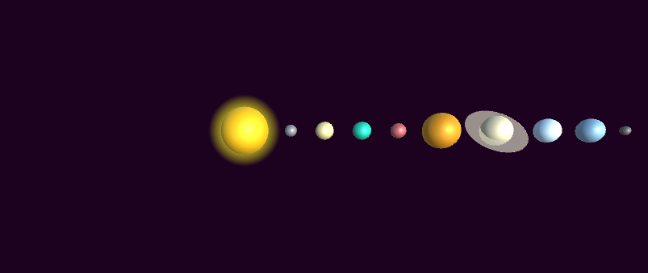
Operational Model Using Unity3D
Phase 1: The sun is placed at the center of the map and the planets (and dwarf planet) are aligned in its proper order.

Slide 12
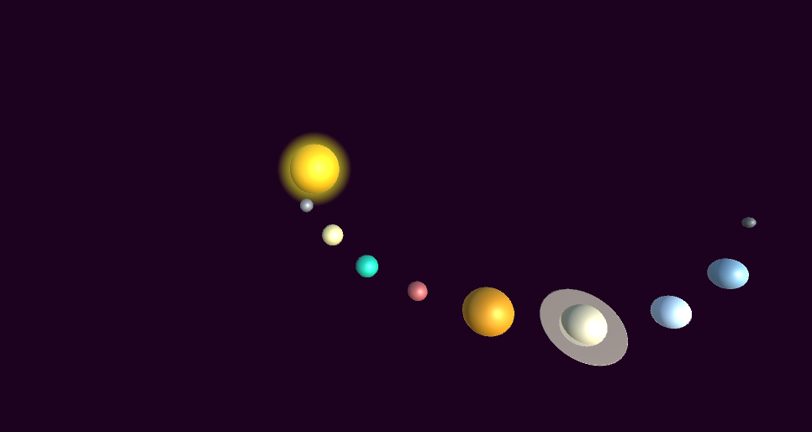
Operational Model Using Unity3D (Cont)
Phase 2: The planets are set to various speeds and is starting to make a curve.

Slide 13
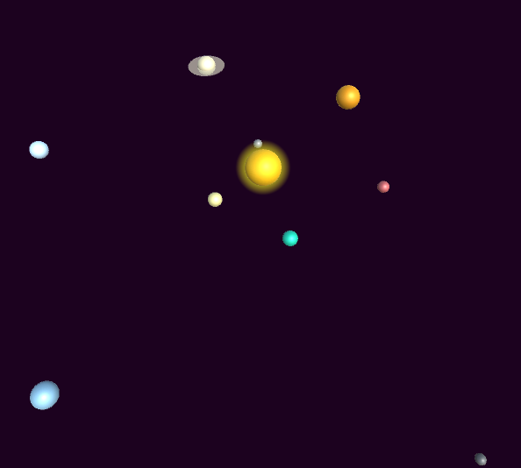
Operational Model Using Unity3D (Cont)
Phase 3: After a period of time the planets are completely scattered.

Slide 14
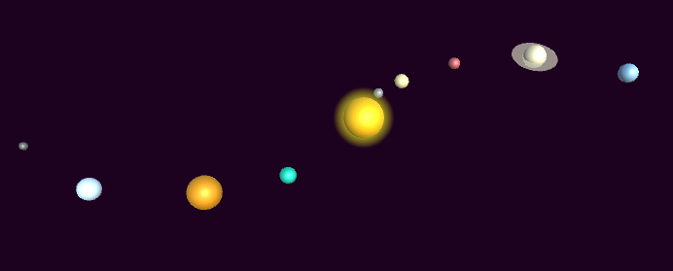
Operational Model Using Unity3D (Cont)
Phase 4: The planets in the Solar System will eventually align together once again.

Slide 15

The End

